Slide 1

Employee Management System
2410030313-P.Bharath
2410030419-S.Thanveesh
2410030462-T.Nisahnth

Slide 2
Driving Growth: Expected Outcomes
Smarter Decisions
Boosted Engagement
Early Warnings & Recognition
Leaders can base promotions and rewards on real-time analytics, ensuring fairness and accuracy.
Employees receive clear, ongoing feedback, which drives motivation and continuous improvement.
Instant alerts help spot and fix issues promptly, while top performers are quickly recognized and rewarded.
Less Manual Work
Better Retention
Automated reports replace tedious HR tasks, saving valuable time and reducing human errors.
At-risk employees are identified early, allowing for personalized support to keep teams engaged and reduce turnover.

Slide 3
About the Dataset
Contains 100,000 rows of employee data from a corporate environment
Captures key metrics across performance, productivity, and demographics
Key Data Fields:
Employee_ID: Unique identifier
Education_Level: Highest degree attained
Department: Area of work (Sales, HR, IT, etc.)
Performance_Score: 1 (Low) to 5 (High)
Gender: Male, Female, Other
Monthly_Salary: USD, based on role and performance
Age: 22–60 years
Work_Hours_Per_Week: Weekly work hours
Job_Title: Role (Manager, Analyst, Developer, etc.)
Projects_Handled, Overtime_Hours, Sick_Days
Hire_Date: Date of joining
Remote_Work_Frequency: % of remote work (0% to 100%)
Years_At_Company: Employee tenure
Employee_Satisfaction_Score: 1.0 to 5.0

Slide 4
Potential Use Cases
Churn Prediction
Productivity Analysis
Performance Evaluation
Identify trends and early signals of employee resignation.
Assess factors influencing productivity (e.g., remote work, overtime, training).
Discover relationships between performance scores and variables like salary.

Slide 5
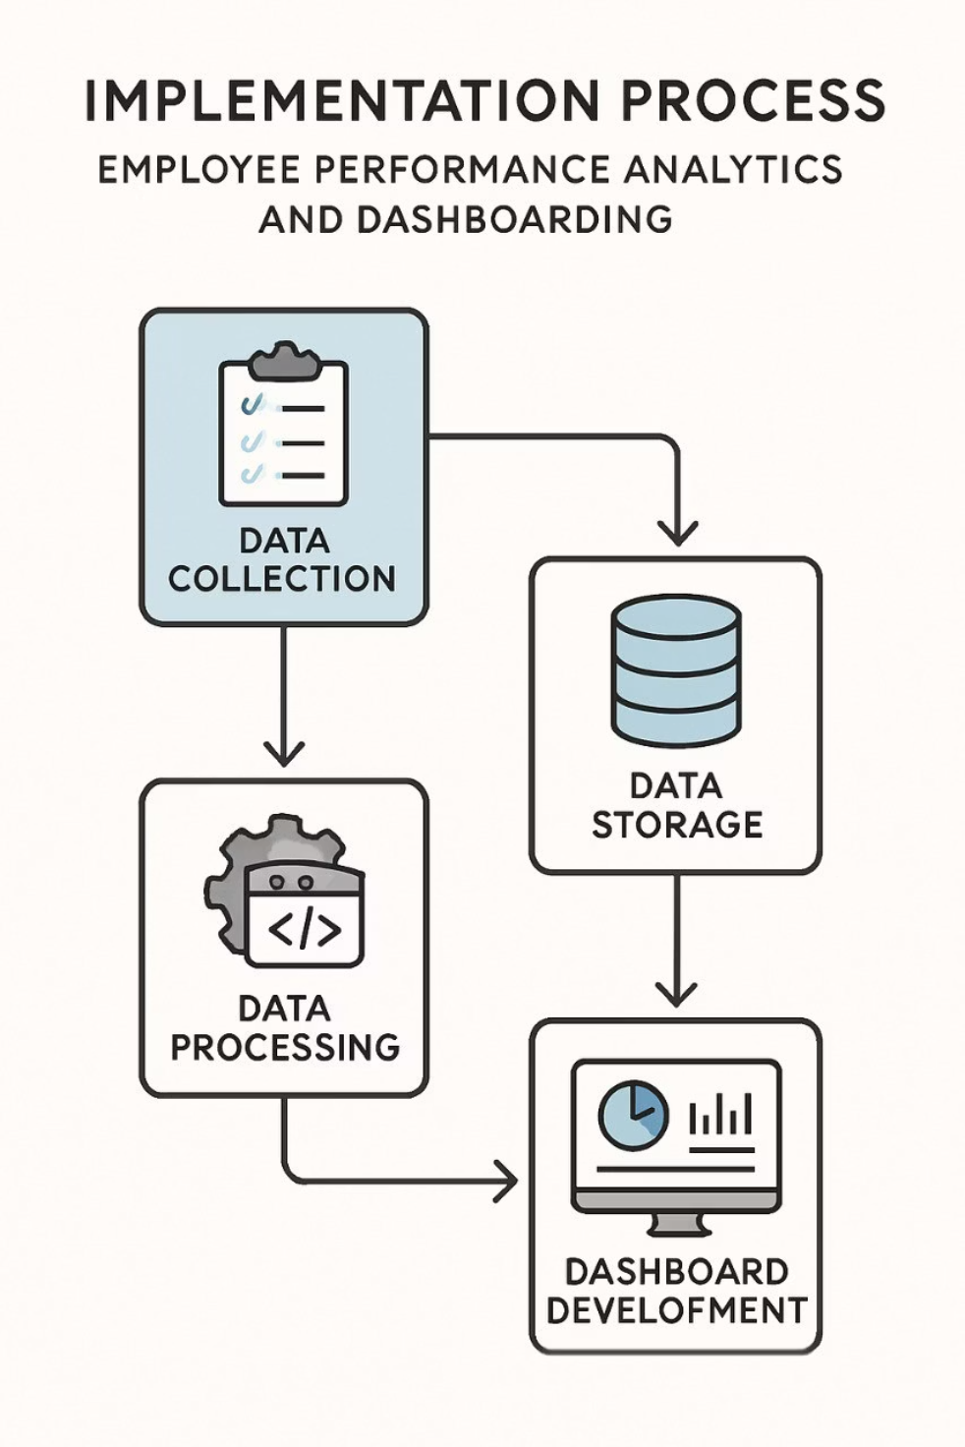
Programming Languages and Tools
Data Processing, Analysis, and Modeling
Python
Data Storage and Querying
SQL
Dashboard and Web App Development
Python (with Dash, Streamlit, or Flask)
Dashboard and Web App Development
JavaScript

Slide 6

THANK YOU

